Slide 1
Ambiguous CFG Grammer –Simplification

Slide 2


Slide 3
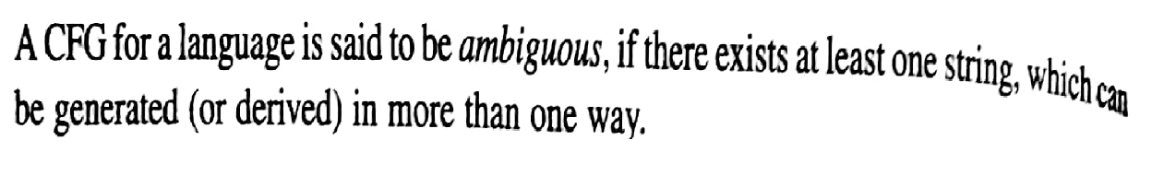
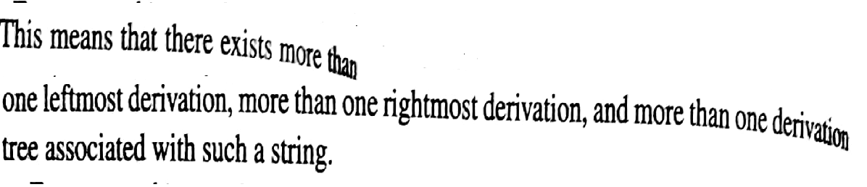

Slide 4
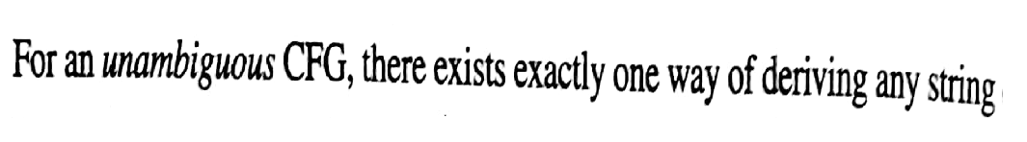

Slide 5
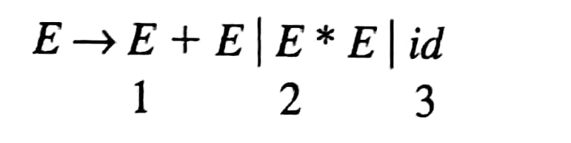
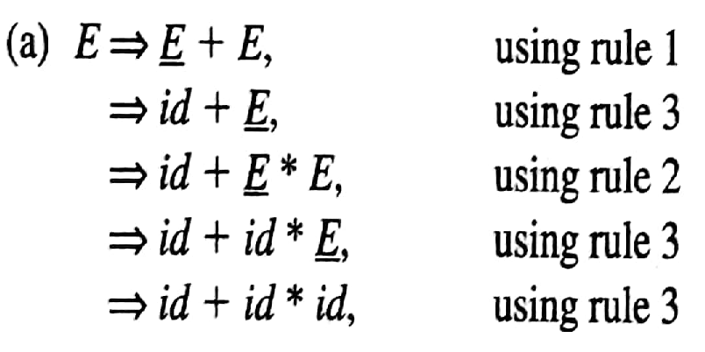
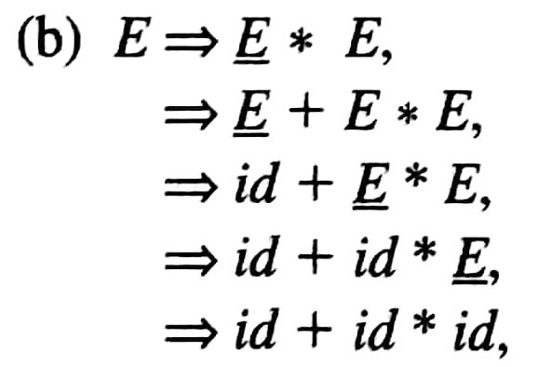

Slide 6
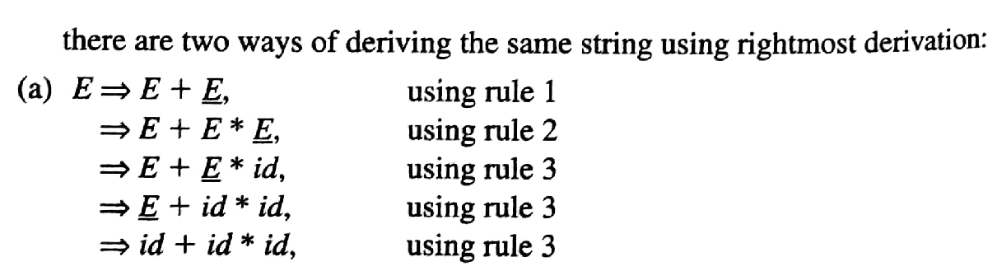
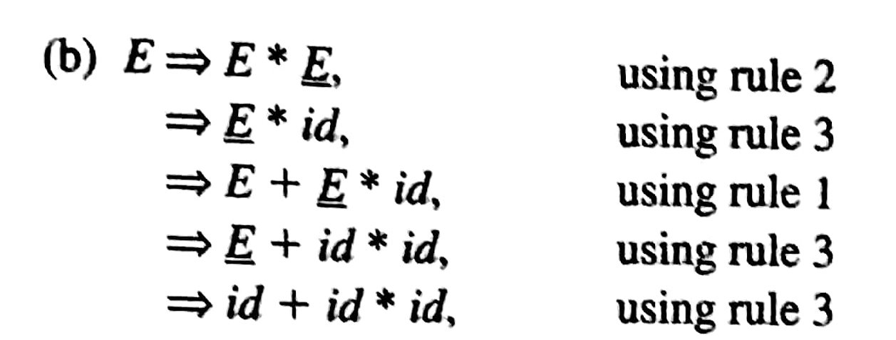

Slide 7

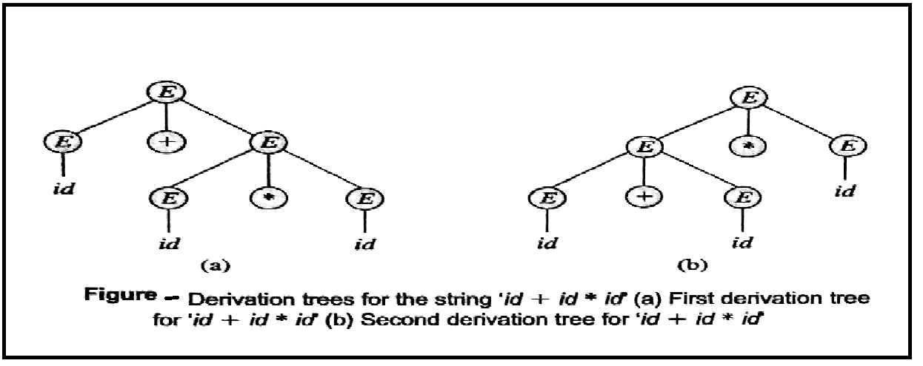

Slide 8
Removal of Ambiguity
Ambiguous Grammar: id +id * id
Unambiguous Grammar:
E -> E + T / T
T -> T * F / F
F -> id
E -> E+E | E*E | E^E | id
Ambiguous Grammar: id *id ^ id
Unambiguous Grammar:
E -> E + T / T
T -> T * F / F
F -> G ^ F / G
G -> id

Slide 9
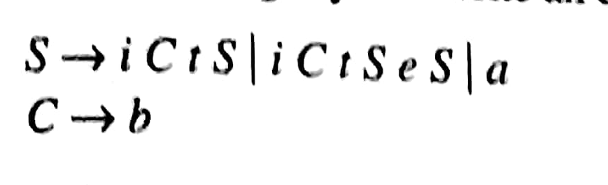
Check if following Grammar is Ambiguous?

Slide 10
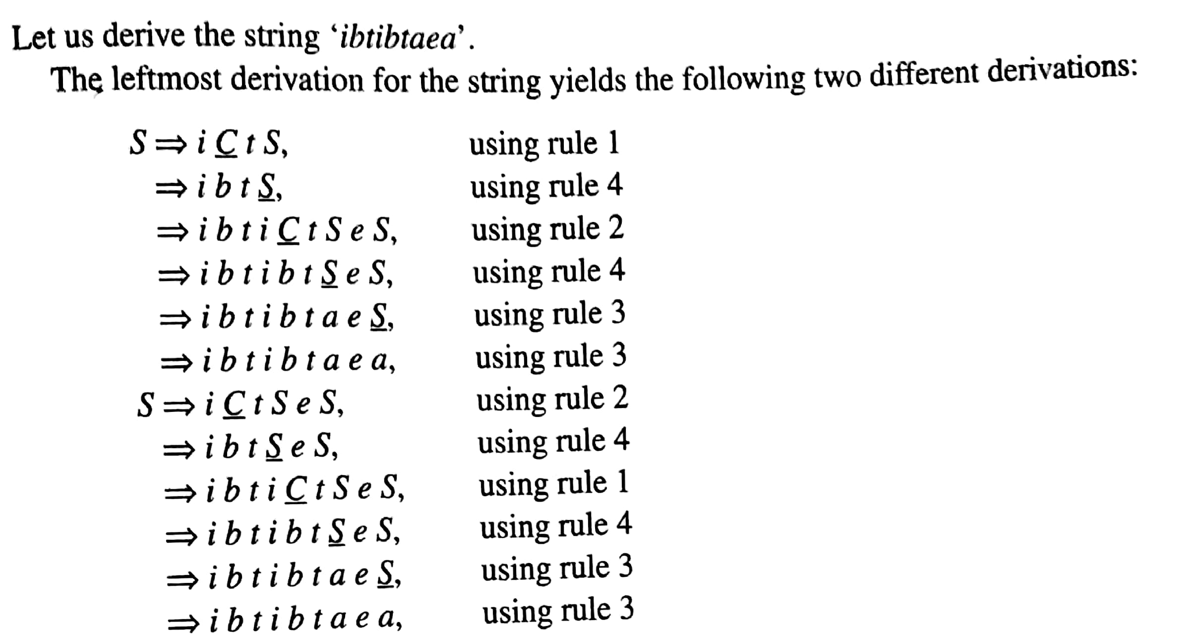
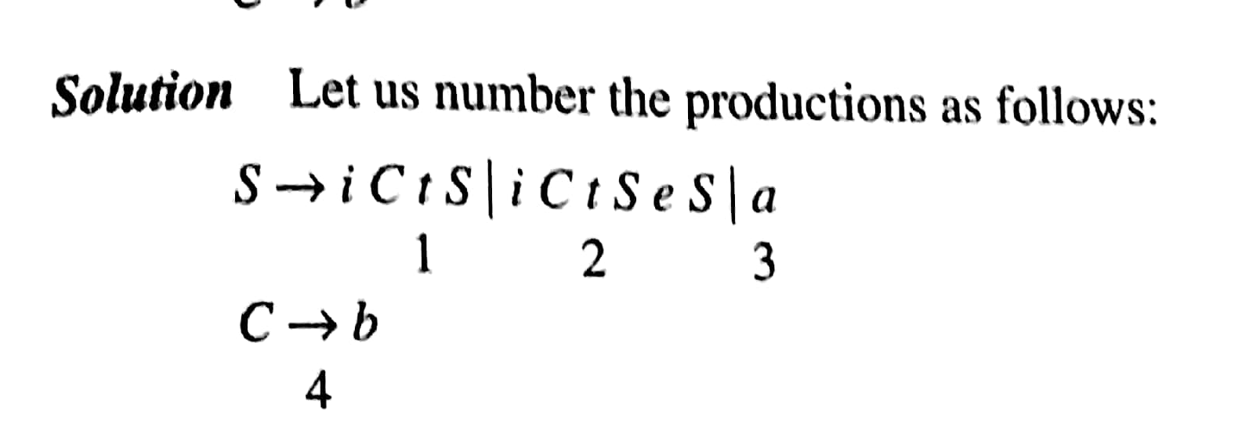

Slide 11
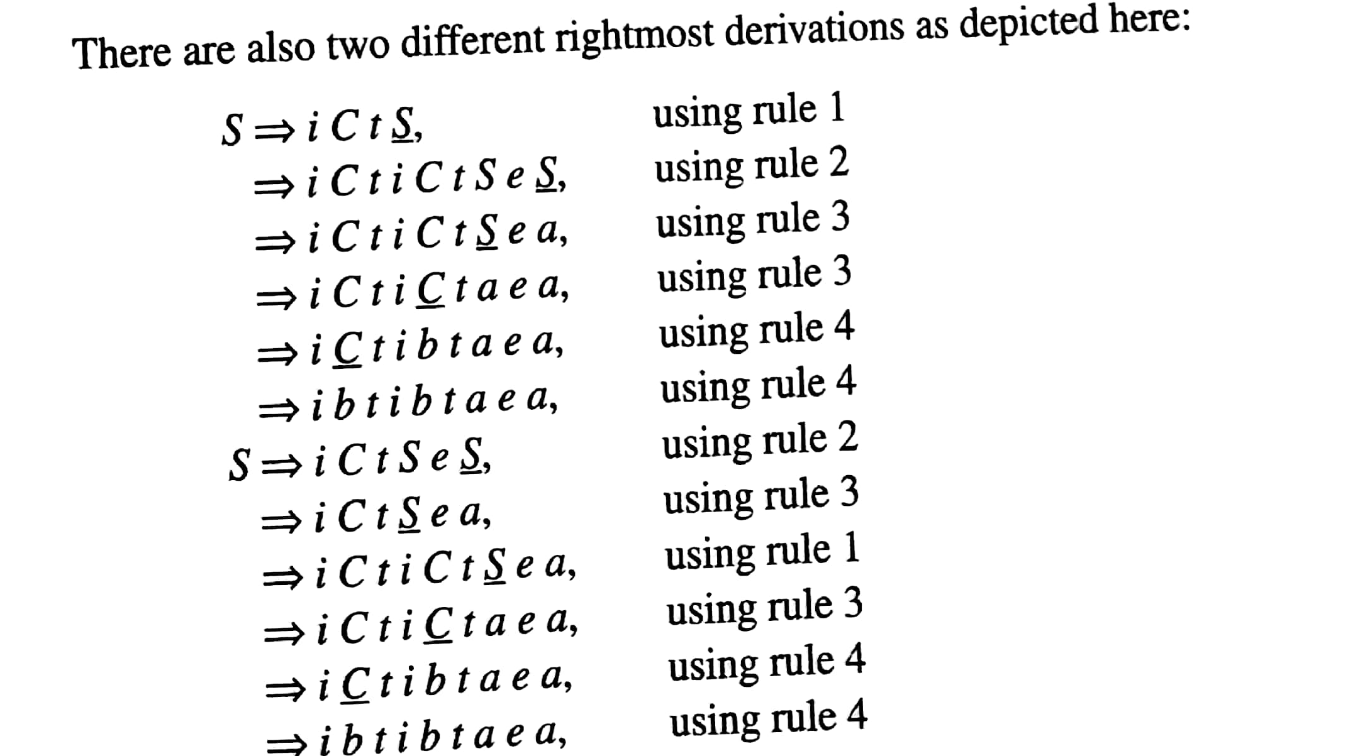

Slide 12
Removal of Ambiguity

Slide 13
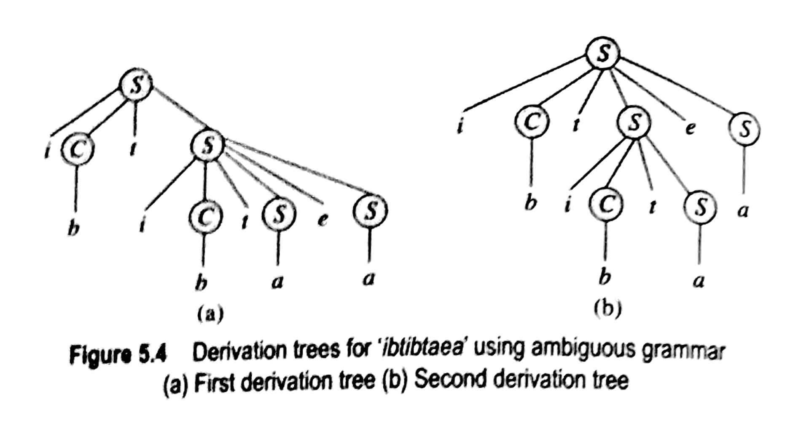
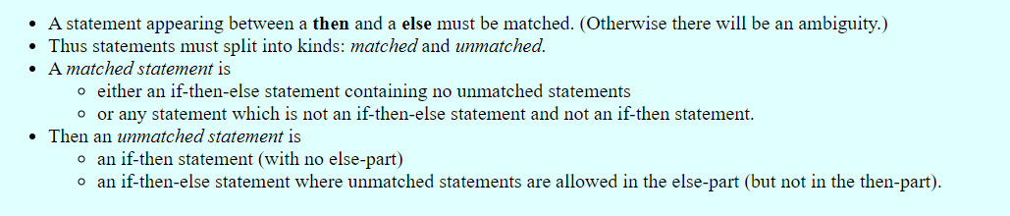
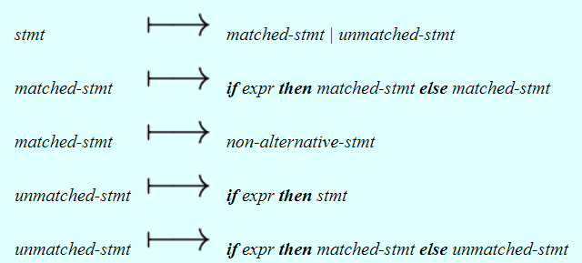
In all programming languages with if-then-else statements of this form, the first parse tree is preferred. Hence the general rule is: match each else with the previous closest then. This disambiguating rule can be incorporated directly into a grammar by using the following observations.

Slide 15
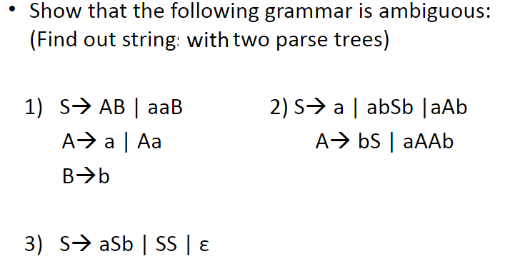
Practice Problems

Slide 16

-- Removal of useless symbols
-- Removal of Unit Productions
-- Removal of ϵ - productions

Slide 17

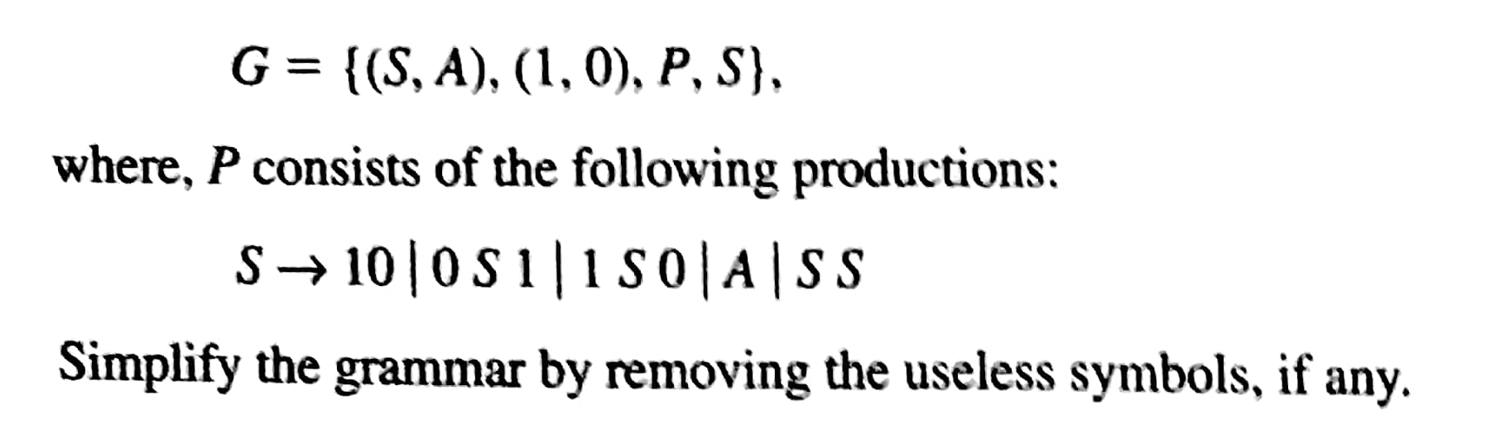
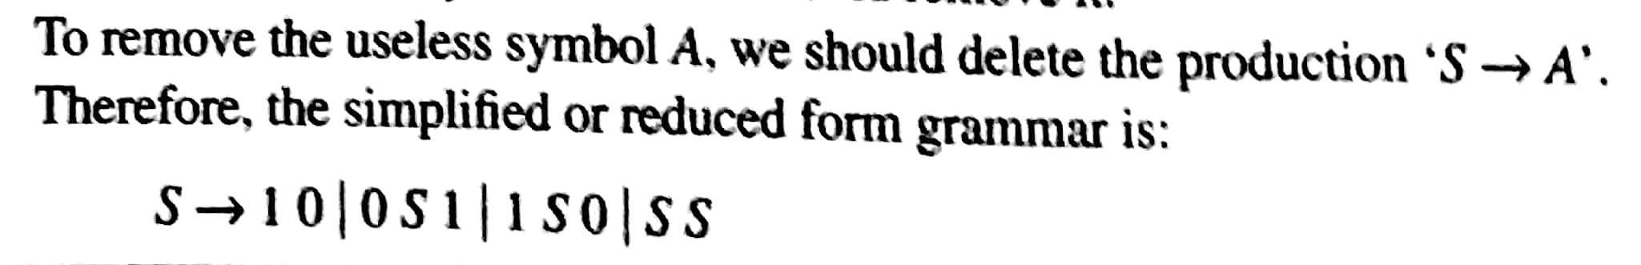
A symbol X is useless if it would not appear in the derivation of any string w ϵ L(G) i.e if symbol can not derive any string of terminals.
To remove useless symbol from grammar, delete all production rules that contain this useless symbol.

Slide 18
Consider the Grammar S🡪AB |a A🡪 a Remove the useless symbols from above grammar.
Removal of Useless Non terminal
B is a useless Non terminal having no production rule. After removing B
S🡪a
A🡪a
S🡪a
A🡪a
Here S is a start symbol and A is useless Non terminal
Sol : S🡪a

Slide 19
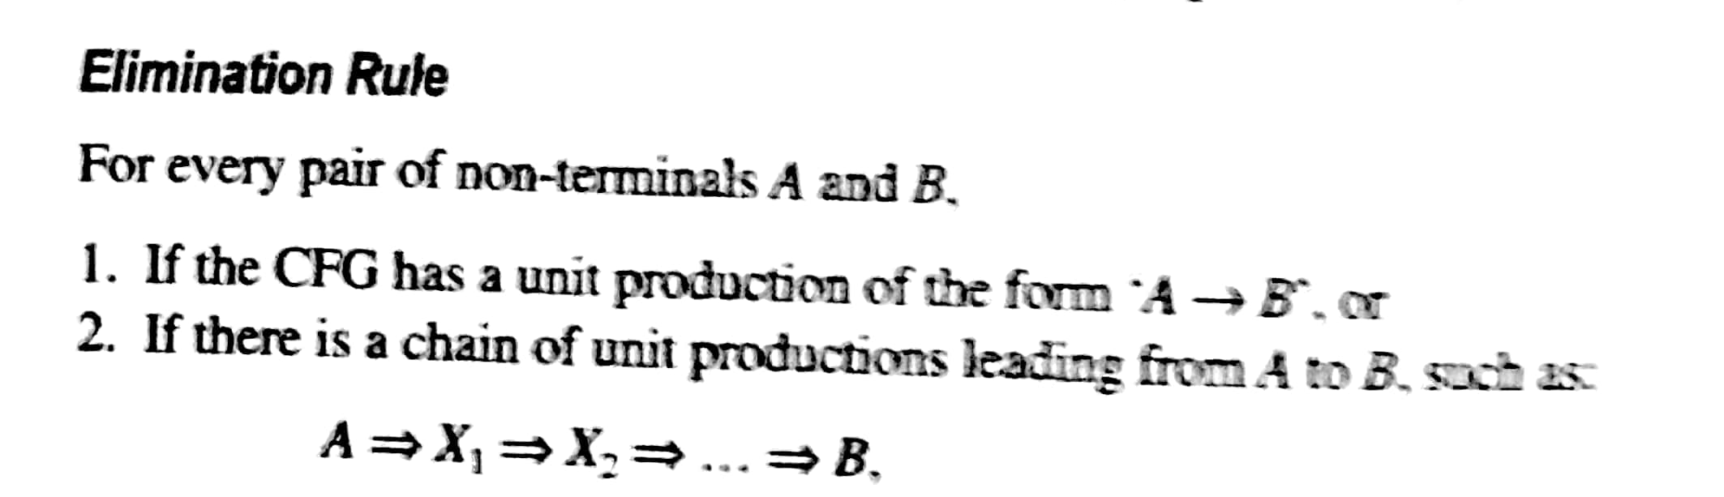
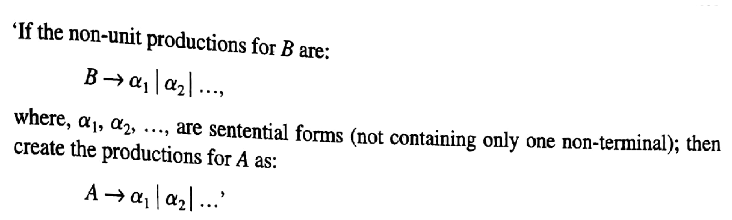
Removal of Unit Productions
A production rule of the form A🡪B , where both A and B are non terminals is called as Unit production rules.

Slide 20

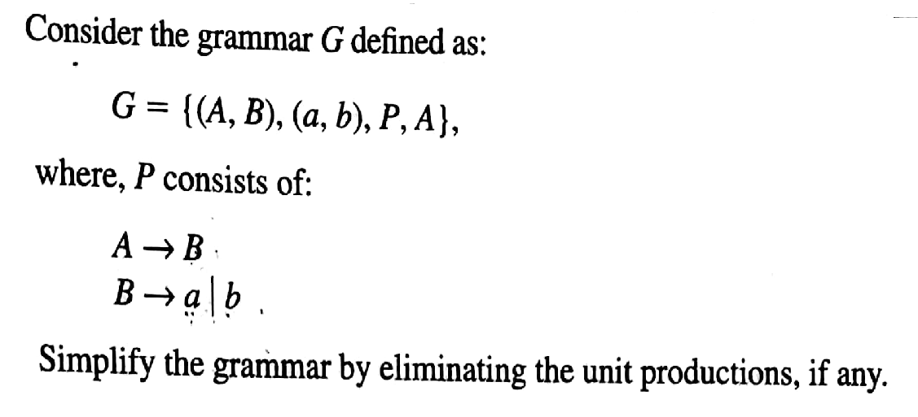

Slide 21
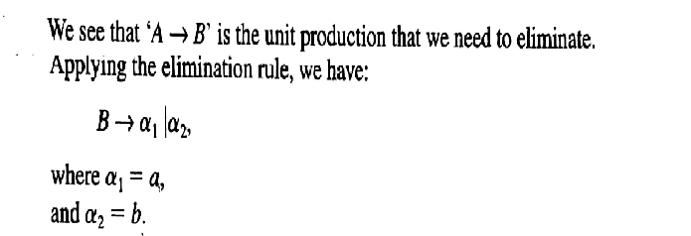
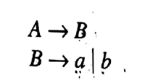
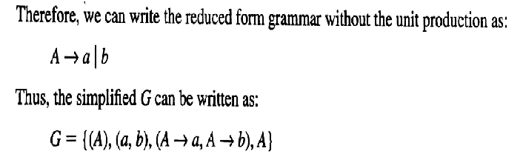

Slide 22
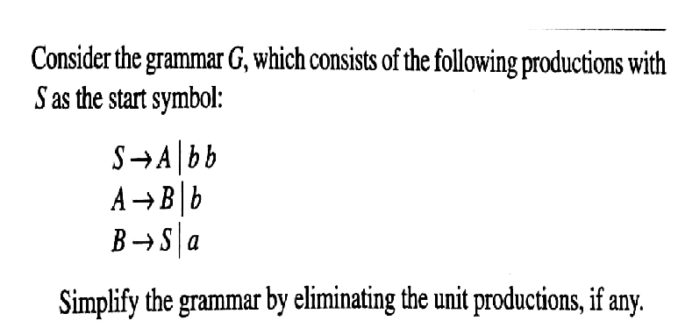

Slide 23
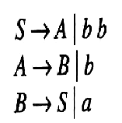
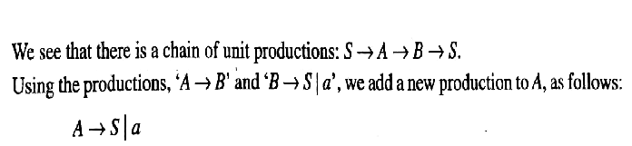
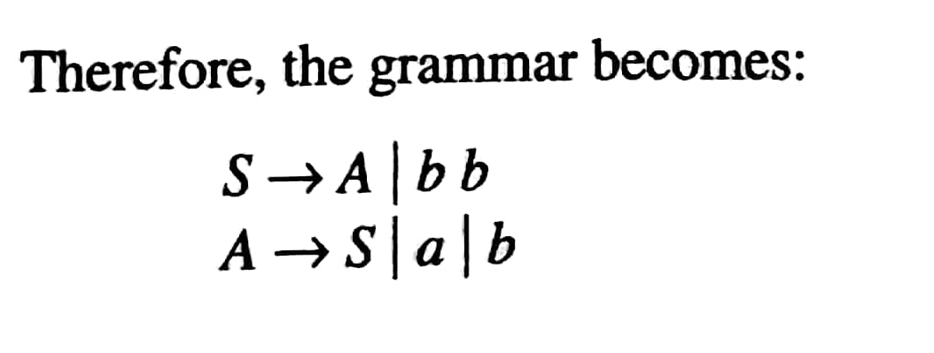


Slide 24
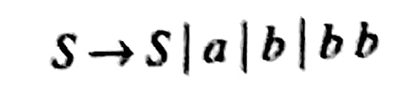
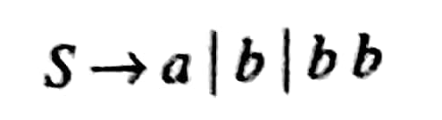
There still exist production rule of the form S🡪S
After removing S🡪 S, final Grammar will be :

Slide 25
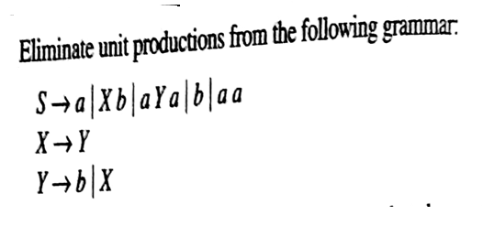

Exercise
There are two unit productions

Slide 26
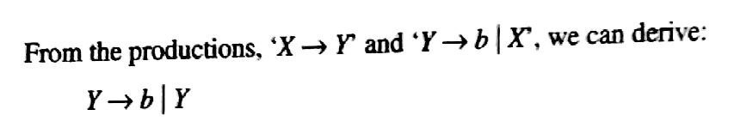

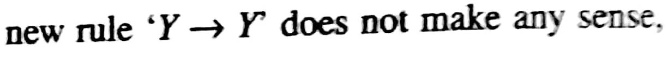
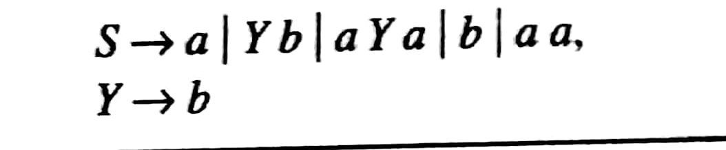
Exercise

Slide 27

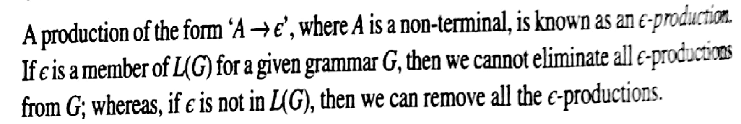

Slide 28
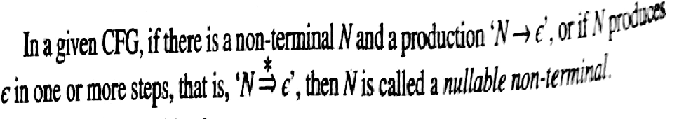
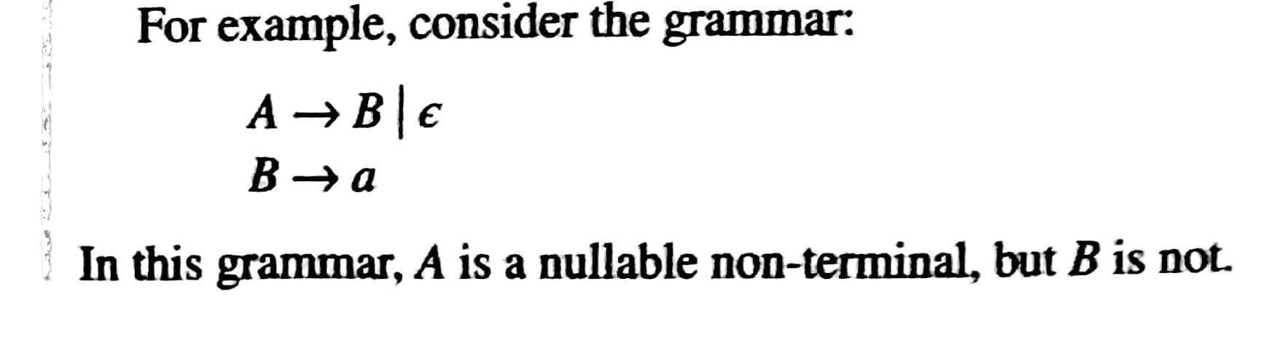
Nullable Non terminal

Slide 29
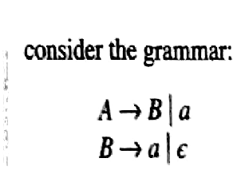
Nullable Non terminal
How many Nullable Nonterminals Eixsts in above G?

Slide 30
Nullable Non terminal
How many Nullable Nonterminals Eixsts in above G?

Slide 31
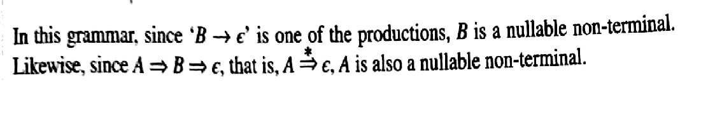
Nullable Non terminal
How many Nullable Nonterminals Eixsts in G?
Ans: 2 , Nullable nonterminals are A and B

Slide 32
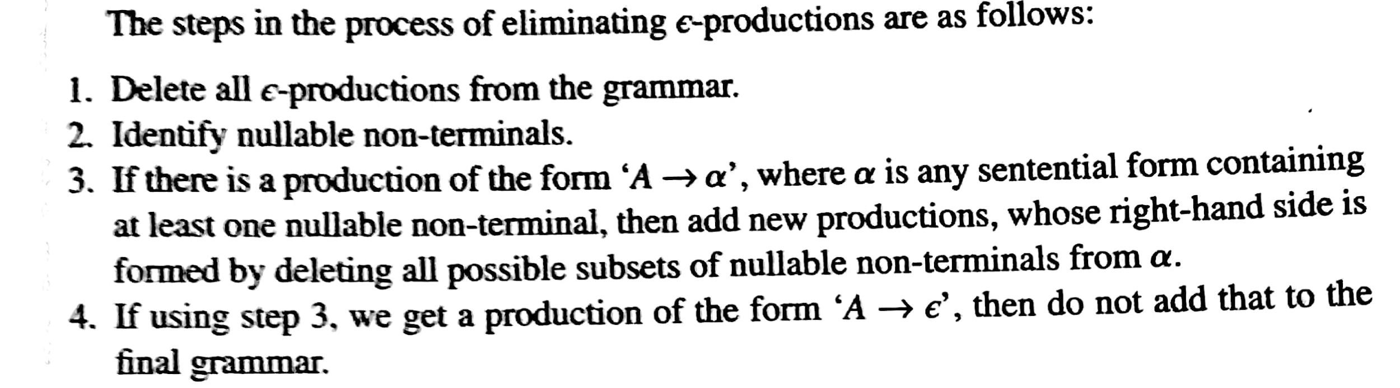
Removal of epsilon Productions

Slide 33
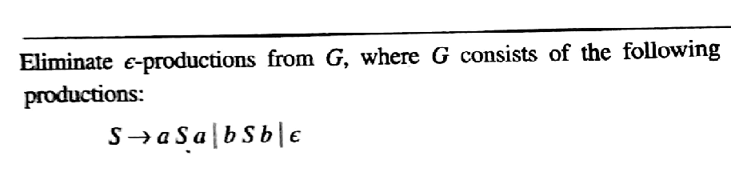
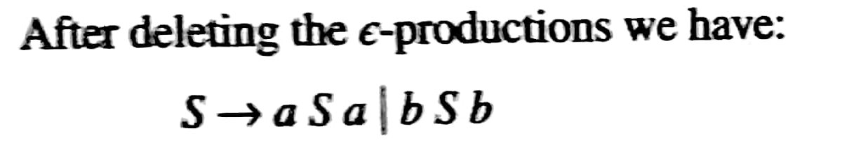
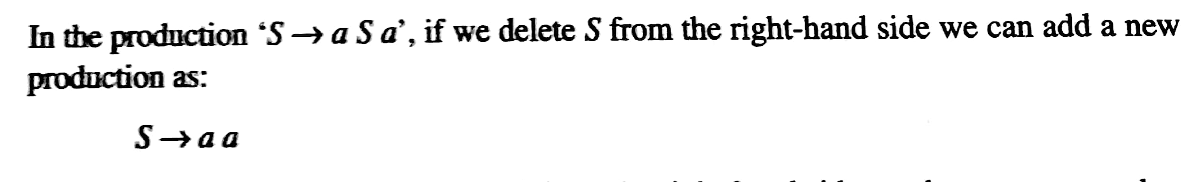

Slide 34
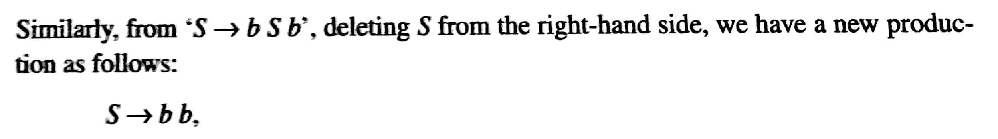
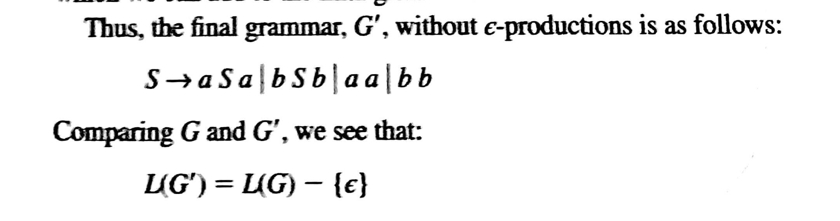

Slide 35
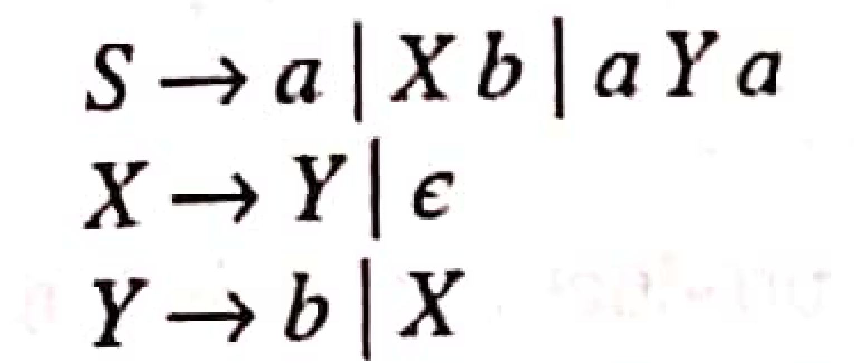
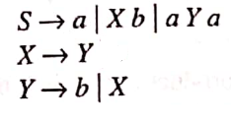
Eliminate ε – productions from following Grammar. Compare language generated by new grammar with language generated by given grammar .
Step 1: Rewrite given grammar by deleting ε – productions from it.
Step 2: Identify NNTs
X and Y are NNTs

Slide 36

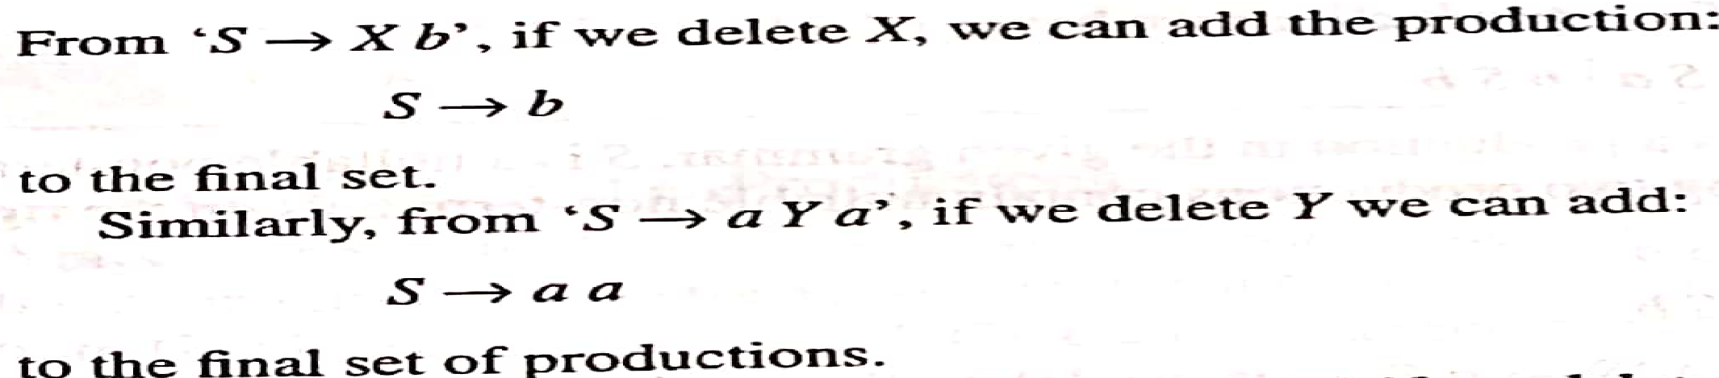
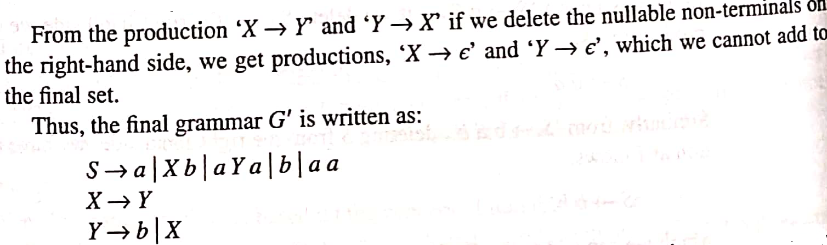
Step 3:
Both L(G) and L(G’) do not contain ε string . Hence L(G) = L(G’)

Slide 37


Eliminate ε – productions from following Grammar. Compare language generated by new grammar with language generated by given grammar .
Step1:
Step2: S,A,B are NNTs
Step3: Consider S->ABA,

Slide 38


Step3: Consider S->ABA,
L(G’) = L(G) - {ε}

Slide 39


Eliminate ε – productions from following Grammar. Compare language generated by new grammar with language generated by given grammar .
1)
2)

